Slide 1
Password Managers
Marina Moshchenko, Iulian J Irimina

Slide 2
Why password managers
Passwords are old technology that doesn’t seem to be replaced in the near future
Some studies point to the fact that secure passwords are difficult to remember and users have difficulty matching their passwords to accounts
Experts recommend you do not reuse passwords
Some websites still require users to create login questions to help with user authentication.

Slide 3
Common Security Questions
What Is your favorite book?
What is the name of the road you grew up on?
What is your mother’s maiden name?
What was the name of your first/current/favorite pet?
What was the first company that you worked for?
Where did you meet your spouse?
Where did you go to high school/college?
What is your favorite food?
What city were you born in?
Where is your favorite place to vacation?
Using questions like these, researchers at Microsoft and Carnegie Mellon found that people with no knowledge of the person whose account they were hacking were able to guess the correct answer 15% of the time.
the majority of these questions are topics that are discussed on a first date and are common material for social network profiles and updates.
How Identity Thieves Get The Answers to Your Computer Security Questions

Slide 4
What is a password manager
Password managers represent a possible solution that addresses the issues of memorability and keeping track of of passwords.
Passwords managers help you generate unique and strong passwords and store them in one safe (encrypted) place,
You only need to remember one master password.
The master password unlocks your encrypted vault which grants you access to each of your passwords.

Slide 5
Local Password Management
Password managers are able to store your passwords locally on your computer or in the cloud
Password managers have become more convenient to users through browser extensions and native apps for your mobile devices.
Storage hampers the user experience but forces hackers to resort to difficult malware-based approaches like using keyloggers and other advanced tools. (Carnegie-Mellon University)
Since the password is stored on the user's device, the user has total control over its security.

Slide 6
Cloud Storage
Encrypted passwords are stored in a server which provides the convenience of access them from any device
Storage improves accessibility makes passwords recoverable if the user loses the device.
However, the user cannot ensure the security of data and breaches happened in the past
However, if a password manager stores all your passwords in an encrypted format, and your master password only as a "hash" that's the result of an irreversible mathematical process. (Carnegie-Mellon University)

Slide 7
1Password
Platforms: Windows, Mac, iOS, Android, 1Password X Platforms: Linux, Chrome OS
Free-version Limitations: Single mobile device
Two-Factor Authentication: Yes
Browser plugins: Chrome, Firefox, IE, Safari, Edge, Opera
Form Filling: Yes
Mobile App PIN Unlock: Yes
Biometric Login: Face ID, Touch ID on iOS & macOS, most Android fingerprint readers
Storage Option: Locally or Online (Cloud)
Price: Individual Plan-$36/year, Family Plan- $60/year
No free version but it allows for a 1 month free trial
It features the service Watchtower, which notifies you if you have an account that may have been compromised (based on the URL and news reports), a weak password, or even a reused password.

Slide 8
Apple's iCloud Keychain
Platforms: Mac, iOS
Free-version Limitations: N/A
Two-Factor Authentication: Yes
Browser plugins: Safari
Form Filling: Yes
Mobile App PIN Unlock: If
Biometric Login: Face ID, Touch ID on iOS & macOS
Storage Option: Cloud
Price: Free
It allows you to sync and share your passwords between any Apple device that you are logged into using your iCloud account.
If a user has multiple devices, or two-factor authentication for iCloud is enabled, key recovery is accomplished by using another device. If a user has a single Apple device, Apple provides an optional key recovery (escrow) service that allows Apple to have access to decrypt your keychain under certain circumstances.

Slide 9
KeePass
Platforms: Windows, Mac, iOS, Android, Linux
Free-version Limitations: N/A
Two-Factor Authentication: Yes
Browser plugins: None
Form Filling: No
Mobile App PIN Unlock: Depends on version
Biometric Login: Depends on version
Storage Option: Local
Price: Free
It offers local storage option storing passwords on your laptop, desktop, or mobile device.
KeePass is open source, and the source code is available for your review.
Highly technical, open-source nature can be intimidating

Slide 10
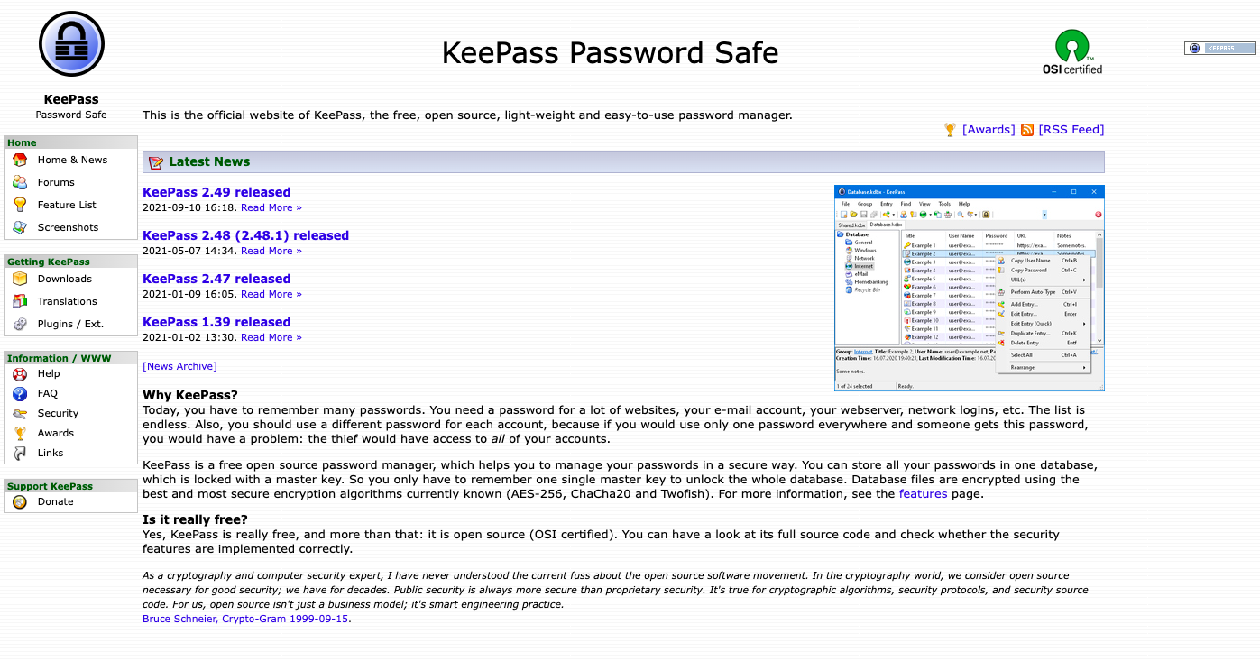

Slide 11
LastPass
Platforms: Windows, Mac, iOS, Android, Linux, Chrome OS, Windows Phone, watchOS
Free-version Limitations: Limited password sharing, limited 2FA
Two-Factor Authentication: Yes
Browser plugins: Chrome, Firefox, IE, Safari, Edge, Maxthon, Opera
Form Filling: Yes
Mobile App PIN Unlock: Yes
Biometric Login: Face ID, Touch ID on iOS & macOS, most Android & Windows fingerprint readers
Storage Option: Cloud
Price: Free (Premium Plan-$36/year, Family Plan- $48/year)

Slide 12
LastPass
The premium users benefit from dark web monitoring and alerts them if any of their email addresses/accounts have been compromised
Tech Support only for Premium members
2015 Security Breach, 2017 & 2019 Reported Security Vulnerability (did not affect user passwords/accounts)

Slide 13
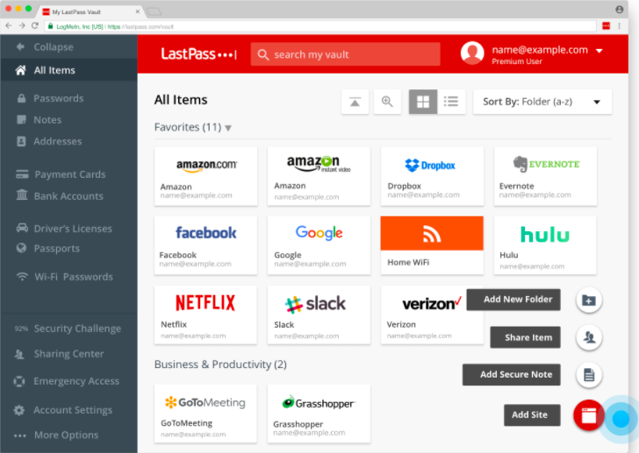

Slide 14
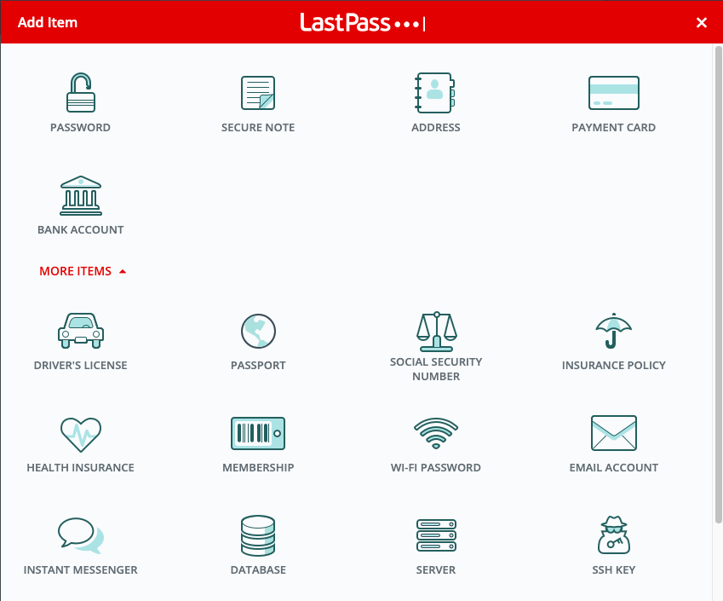
Other info you can store

Slide 15
Google Password Manager
Is not recommended for storage and syncing using Chrome as Google has access to your unencrypted passwords. ( Carnegie Mellon)

Slide 16
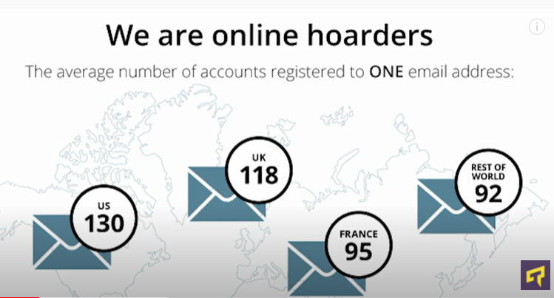
DID YOU KNOW???
Notes:
https://www.youtube.com/watch?v=DI72oBhMgWs

Slide 17
DID YOU KNOW???
Roughly 6.85 million accounts get hacked every single day
51 percent of people utilize the same passwords for personal and work accounts
About 23 million people still secure online accounts with a simple password like 123456

Slide 18
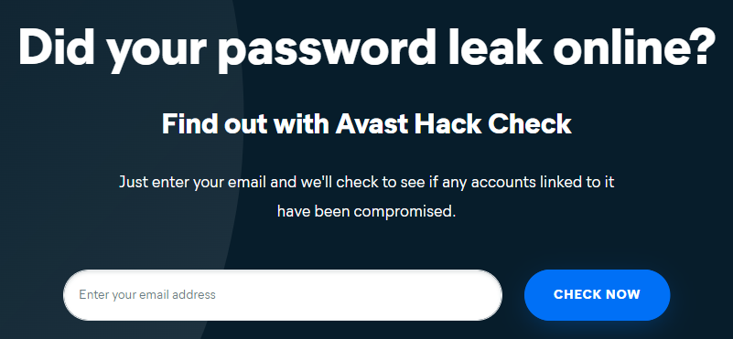
Did your password leak online?
https://www.avast.com/hackcheck/

Slide 19
Can password managers get hacked? YES!
As any other application…
The vast majority of cyber-security specialists agree that password managers are indeed the most secure way to protect your passwords.

Slide 20
PM PROS
Humans can be unreliable as they can come up with bad passwords, forget their password, or are genuinely disinterested in security. With a PM there is no need to worry about remembering all your different passwords.
Using the same credentials for each account is dangerous as it creates one point of failure.
Good password managers encrypt all your personal data in case someone hacks the PM software directly; the hacker might get your passwords but they won’t know who the passwords belong to.
PMs can keep you up to date with the latest breaches and advise you if any accounts may have been affected/hacked.
Can use offline password manager (not stored on the web/not a web browser plugin).

Slide 21
PM CONS
Single point of failure - if someone gets hold of your master password, they have all your passwords.
Password manager programs are a target for hackers.
It's not easy to login using multiple devices.
If the main password is used/typed/saved on a computer with malware, your main password can compromise all your other passwords controlled by the PM - all your passwords are only as secure as your master password.
Not all PM's are adequately encrypted which can render the whole process of setting one up useless.
Password Manager breach.

Slide 22
Common Password Encryption & Hash Formats
Password example: R@nT4g*Ne!
FORMAT | DESCRIPTION | SECURE PASSWORD (EXAMPLE)
SHA-1 | Password is made up of 40 hexadecimal characters, and there is no clear decryption method. 160 bits | 12bf203295c014c580302f4fae101817ec085949
SHA-1 with Salt | Password is still made up of 40 hex characters, but we appended the word "Free." 160 bits | bc6b79c7716722cb383321e40f31734bce0c3598
MD5 Message Digest | Password is encoded into a 128-bit string. This tool provides a quick and easy way to encode an MD5 hash from a simple string of up to 256 characters in length - 32 hex characters. Widely used. Collisions possible. | 4e84f7e8ce5ba8cdfe99d4ff41dc2d41
SHA256 | Password is encoded into a 256-bit string. Created by the National Security Agency in 2001 as a successor to SHA-1. Data may be of unlimited size 64 hex characters. Widely used. Slower than MD5. | 5fd0c5bebb6481579f9028b3dfa7bed982e30830315072a803197e83067224db
SHA512 Secure Hash Algorithm | Secure Hash Algorithm 512, is a hashing algorithm used to convert text of any length into a fixed-size string. Each output produces a SHA-512 length of 512 bits (64 bytes) 128 hex characters. Not widely used yet. | d3b21eeeb5b6c20a54d8cd2b0a2e16ab9e572dd0b1b181b174783e38c9d0fa1b0f6da952be405b35e232d7e6914bca10a4feb8815797a3d1cb3b119f02764528
AES Advanced Encryption Standards | With this symmetric encryption algorithm, you can choose bit length. It's nearly impossible to model what our completed password might look like, as we have far too many variables to choose from, and each will impact the outcome. Used to scramble data while in transit and unscramble it when it reaches the legitimate destination. | Nearly impossible to model due to multiple variables
Notes:
Plain text
Use encryption on text
Use a hash function
Understanding password safety is a bit like learning a new language. Several tools exist to transform your passwords, and they all work a bit differently.
Imagine that our password is R@nT4g*Ne! (Rent Forgone, in common terminology.) Let's pass this through several different encryption tools
The number of possible values that can be returned by a a 256-bit hash function, for instance, is roughly the same as the number of atoms in the universe.
https://emn178.github.io/online-tools/md4.html

Slide 23
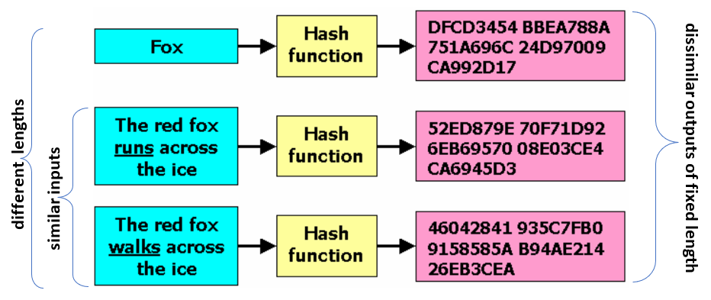
Secure Hash Algorithm

Slide 24
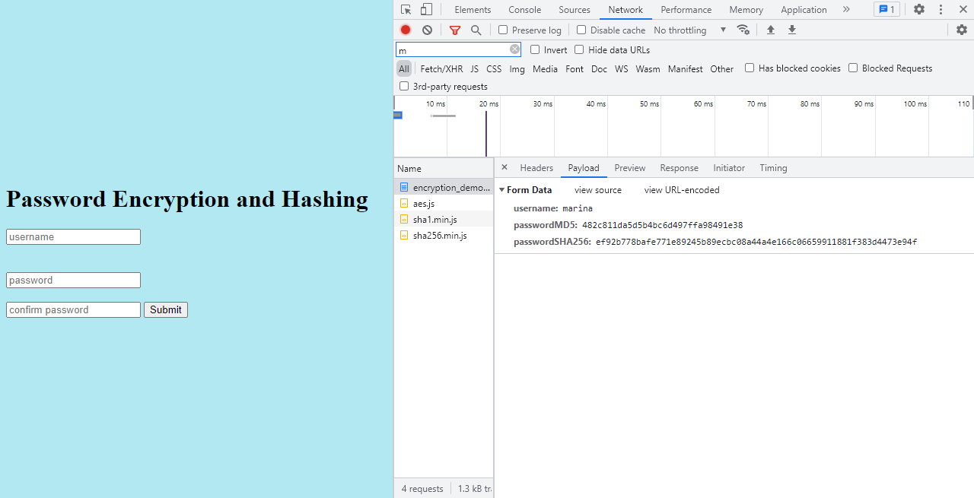
Coding Sample

Slide 25
How to crack a hashing system
Steal a list of hashed passwords from a server
Pick a password attempt
Hash it
Compare the hashed result with all of the hashes in the stolen database.
If you find a match, you have guessed one password
Or decrypt (and encrypt) up to 100 hashes :
https://md5decrypt.net/en/#answer

Slide 26
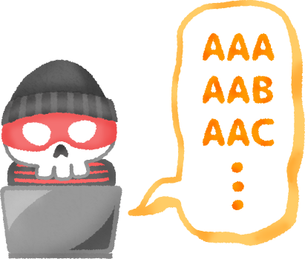
How to brute force in record time (Rainbow Tables)
Start with a dictionary of million common passwords
Hash each word (may take many days to compute the entire list)
Store the password and its hash in a (very large) database
Quickly apply brute force methods using pre-computed values
Download your own rainbow tables here… http://project-rainbowcrack.com/table.htm
Notes:
Hackers has hard drives full of rainbow tables with the list of passwords and hash values for them. Even if the hash takes a lot of time to generate, they have already done the work ahead of time for common passwords. Never use a password of a lowercase only or a common word. It was already cracked many years ago. They are just waiting for you to use it.

Slide 27
How to defeat Rainbow Tables?
Best:
SALTING A PASSWORD - add unique number before the password and then hash it. So that way it does not fit into anybody’s precomputed or rainbow tables.
OR
MULTIPLE ROUNDS OF HASHING (repeat an algorithm multiple times)
Notes:
The word salting comes from ancient times if someone invaded a country and wanted to destroy the land and make it unusable for agriculture they just dumped a bunch of salt on it and therefore it is useless.

Slide 28
Can I create my own password manager? YES!
Choose a hash algo easily used by the language and IDE of your choice.
Use it to hash your master password. (you can also create the add, update, reset master password features here; you can also add 2 factor auth with google authenticator)
Store the hash for verification. Even if someone has your password, they would not break the hash in reverse.
Create record table with portal, username, and password fields.
For each record you add, generate a random password (8 characters or more long) using a combination of uppercase, lowercase, numbers, and symbols (@ works on most portals)
Ensure that you do not update an existing record for the same. For safety, just use add and delete features. (make deletion harder with multiple confirmations and requiring master password)
Encrypt the records file. (different from hashing as you will decrypt it to use e.g. multiply a number by 5 to encrypt, divide by 5 to decrypt)
Use the random passwords on your logins. You are done.
(Optional) You can sync your encrypted records file to google drive to allow you to use the file on multiple devices.

Slide 29
Resources
https://www.cmu.edu/iso/governance/guidance/password-managers.html
https://stumbleforward.com/2012/08/20/the-10-most-common-password-security-questions/
https://cheatsheetseries.owasp.org/cheatsheets/Choosing_and_Using_Security_Questions_Cheat_Sheet.html
https://www.acm.org/articles/people-of-acm/2016/lorrie-cranor
https://dl.acm.org/doi/10.1145/3412841.3442131
https://www.youtube.com/watch?v=GI790E1JMgw
https://us.norton.com/internetsecurity-privacy-password-manager-security.html
https://us.norton.com/internetsecurity-privacy-password-manager-security.html
https://expert.services/blog/managing-your-website/security/password-managers

